Slide 1
digital rights and assets management platform
DigiRAMP is a disruptive PaaS which enables users to securely store, manage, license and distribute their content with simple and quick delivery in a transactional marketplace.
Work->Owner->Rights->Marketplace

Slide 2
Intellectual Property • Big Business
Forecast: the music industry revenue worldwide from 2013 to 2018. According to PwC, the revenue will grow from 47.4 billion U.S. dollars in 2013 to just over 50 billion in 2018.
International license and royalty payments and receipts for media and music content are increasing by an average annual rate of 10.6%
-Source: OECD, Technology Balance of Payments Database
DigiRAMP will capture B2B (industry) customers and rapidly develop its enterprise business capitalizing on astronomical growth in this marketplace.

Slide 3
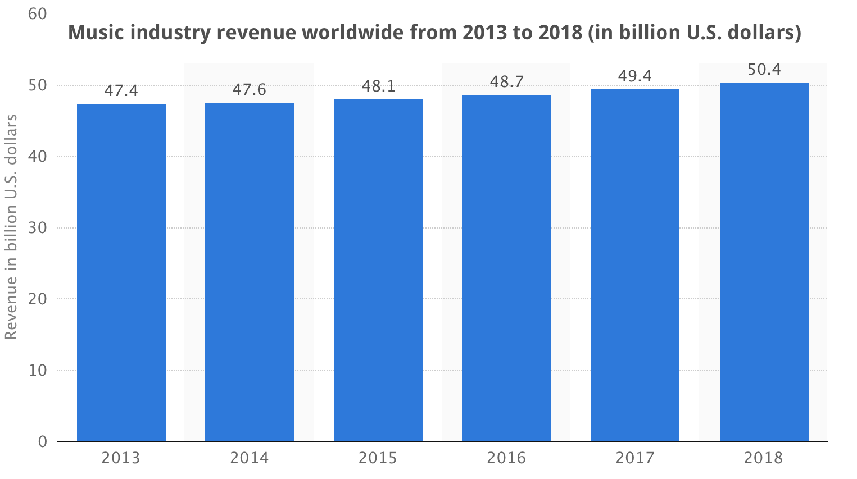
Future Growth
Statistic provides a forecast of the music industry revenue worldwide from 2013 to 2018. Total revenue will grow from 47.4 billion U.S. dollars in 2013 to just over 50 billion in 2018. - PwC

Slide 4
What is Intellectual Property?
intellectual property (IP) refers to works which are creations of the mind, used in commerce:
Everything starts with a “Work”
DigiRAMP supports all content formats
Core focus on rich media:
Music • Video • Images

Slide 5
What is the Intellectual Property Licensing Industry?
Businesses in this industry assign rights to assets such as recordings, catalogs and franchise agreements for which a royalty or licensing fee is paid to the asset holder. Owners control the rights and allow others to use works for a fee.
Each work has unique assets and key information required for all media-transactions. Managing and maintaining complex data sets is a huge problem for the industry.
DigiRAMP provides secure storage and correlation of assets and databases containing legal and financial information making it easy to conduct transactions.

Slide 6



Music Licensing Made Simple
Songwriter & Producer
Publisher & Label (owners)
DigiRAMP: License to use Song
Recorded Music
Downloads • Sales
TV/Movies/Video/Games
Broadcast • Streaming
Distribution
Print• Bundle
Mechanical
Synchronization
Sub-Publisher

Slide 7
Works, Owners & Rights are traded in a “Marketplace”
The DigiRAMP Marketplace services the commercial world; the realm of business, trade, and economics for use or utilization, especially for profit:
Licensing • Distribution • Broadcast •Sync (TV, Film, Video, Internet) • Retail • Venues • Streaming • Radio • Advertisement • Branding• Bundling • Sales & Acquisitions
DigiRAMP connects customers directly with businesses. CRM and a powerful “Opportunity Engine” create value discovery and visibility, making transactions simple and quick. Direct transparent accounting to each stakeholder increases profit/mitigates disputes.

Slide 8
Problem: Vast Ecosystem of stakeholders needs to be involved in every transaction
Work->Owner->Rights->Marketplace
Artists • Publishers • Performance Rights Organizations •Labels
Distributors • Music Retailers
Film and TV Music Supervisors
Broadcasters• Ad Agencies • Brands
iTunes • YouTube

Slide 9
Problem
Work->Owner->Rights->Marketplace
the media business is growing at an astronomical rate; the difficulty of managing complex relationships and transactions between Owners, Works, Rights and the Marketplace has become prohibitive, and financially punitive

Slide 10
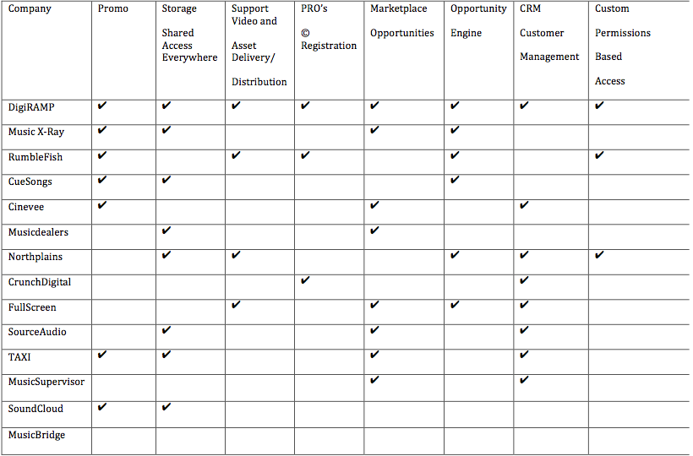
Competitive Landscape

Slide 11
Advantage: DigiRAMP
Competitors, such as RumbleFish, SyncTank, CueSongs, Music X-ray, SoundCloud, & SourceAudio offer only portions of a complete eco-system.
DigiRAMP is a democratized platform which supports exploitation across the entire digital content chain.
We connect buyers and sellers enabling transactions compliant with international industry and rights standards.

Slide 12
Example: Licensing a song
Without DigiRAMP:
With DigiRAMP:
Production needs music (“Master Use” and “Synch License”)
Music Supervisor temps music w/ Director
Creative tone, genre & duration are established
Supervisor sends request to Owners to replace music
Owner submits creative pitches
Supervisor selects cue and gets approval from Producer
Legal issues clearance forms to owners: Publishers & Label
Publishers & Label seek permission to clear from business affairs/Artist
Publishers & Labels issue quote to Supervisor
Supervisor gets approval to issue licenses to owner
Owners sign agreement and wait for confirmation of usage
Upon commercial distribution initial fees are paid to owners
Production company and owners register cue sheets w/ PRO’s
Owners wait for PRO to pay performance royalties (9-18 months)
Buyers searches/selects music
Buyer Issues Quote/Terms
Owner approves Quote
Buyer Pays and receives License
Done!

Slide 13
Solution: DigiRAMP Management Platform
Work->Owner->Rights->Marketplace
DigiRAMP provides a single platform which enables all stakeholders to manage their interests across the entire industry.
By connecting all metadata, rights, assets, contracts, stakeholders, buyers, sellers and financials, the Marketplace is made simple and quick.

Slide 14
DigiRAMP
Work->Owner->Rights->Marketplace
->Management
DigiRAMP is a suite of powerful tools
to manage, distribute, promote and monetize customer and business relationships; with © registration, CRM and licensing support built into workflow.
You control your rights and profit

Slide 15
DigiRAMP: HOW WE MAKE MONEY
DigiRAMP provides a single platform to the 3 key stakeholder groups most in need of a solution:
Creative & Professional Customers
Business Customers
Enterprise Customers
DigiRAMP sells subscriptions and collects fees on every transaction

Slide 16
DigiRAMP Customers
Pro User
Owners: Organize/register rights in standard industry format
Affordable, easy entry/access to marketplace
Promote, market and connect to a global audience and customer base
Distribute content to all social media platforms: Facebook/Twitter/Google+, Instagram, LInkedIn
Licensing & Distribution to commercial, and retail channels (DSPs)
Music Supervisors/ Film & TV / iTunes / Ads, Commercials
Business
Manage/Represent Catalogs
Affordable, easy entry/access to marketplace (B2B)
Promote, market and connect to a global industry and manage customer base (CRM)
Licensing & Distribution to commercial, and retail channels (DSPs)
Music Supervisors/ Film & TV / iTunes / Ads, Commercials/Brands
Team Members co-manage
Unique search tools – advanced and simple to use
Easy clearance / registration of cue sheets
Digital asset transfer and download – Fast and flexible delivery system
Unique “Opportunity” Engine; share requests/manage submissions
Enterprise
Major Publishers
Major Labels
Major Broadcast Networks and Film Studios
Value Proposition:
Self Managed, Enterprise level IT solution; internal storage & security
Customized solutions development
Full maintenance support from Digiramp
Scalability across multiple divisions/Permissions based
All DigiRAMP features including full access to Industry databases
Customer Behavior / Big Data Analytics & reporting platform:
Sales reports, trending content intelligence, metadata analytics, customer behavior

Slide 17
Relationships Relationships Relationships
20th Century Fox
A&M Records
Aaron Spelling Productions
ABC
Ammirati-Puris-Lintas
Apple
Arista Records
Atlantic Records
BBC
BMI
Buena Vista Television
Buena Vista/Disney
Catchlight Films
CBS
Cinemax
CNBC
Columbia Pictures
Columbia Records
Comcat
Compaq
Critique/BMG Records
Dreamer's Moon Music (BMI)
Dreamworks
Dress Circle Records
E! Television
Epic
Epic Records
Epix
Fox TV
HBO
Lifetime Television
MCA Music
MCA Records
Mercury Records
MGA/UA
MGM
Microsoft
Mirage
Modern Records
Motown Records
MTV
National Lampoon
NBC
Nonpareil Records
Oxygen Networks
Paramount Television
PBS
Planet/RCA Records
Playboy Records
Reprise Records
Riverside Entertainment
Rondor Music (BMI)
Showtime
SIGGRAPH
Sizzling Blue Music Skylines Productions
Sony ATV Music
Sony Music
Sony Pictures
Spirit
The Playboy Channel
ThinkFilm
TNT
Toshiba
Touchtone Pictures
TriStar Television
Tunedge
Tunedge Music
UK Channel 4
Universal Pictures
UPN
VH1
Viacom
Virgin Records
Warner Bros. Records
Warner Brothers
Warner-Chappell (US)
Warner-Chappell Intl.
Warner Tamerlane Music
Webo Girl Music
Zomba Songs Inc.

Slide 18
Summary Financials
DigiRamp Financial Summary
($'s in Thousands)
 |  |  | Projected FYE December 31, (a)
 |  |  | 2015 | 2016 | 2017 | 2018 | 2019
Subscribers (Free) |  |  | 1,000,000 | 2,000,000 | 4,000,000 | 8,000,000 | 10,000,000
Paid Subscribers |  |  | 8,750 | 25,000 | 50,000 | 75,000 | 100,000
Visitors per Month |  |  | 4,375,000 | 8,750,000 | 17,500,000 | 35,000,000 | 43,750,000
Revenues |  |  | $1,023.5 | $3,225.0 | $6,553.8 | $10,282.5 | $13,251.3
SG&A |  |  | 2,925.1 | 4,463.9 | 5,228.9 | 6,122.9 | 7,004.9
EBITDA |  |  | $(1,901.6) | $(1,238.9) | $1,324.9 | $4,159.6 | $6,246.4
EBITDA Margin |  |  | 0.0% | 0.0% | 20.2% | 40.5% | 47.1%
Cash |  |  | $2,567.9 | $770.6 | $1,118.1 | $3,311.5 | $6,894.7

Slide 19
Founders
Peter Rafelson - CEO (Los Angeles)
• Thirty years of industry experience (A&R/Producer at EMI, Warner Bros, RMC) with over 300M record sales
• Founder/CEO - managed independent labels, publishing and licensing companies
• Leading expert in cloud computing, design, software development and international consulting to software companies (MicroSoft, Apple, Toshiba, Compaq)
Max Grunlond - CTO (Denmark)
• Masters in computer music - Esbjerg Music Academy
• Twenty five years of experience software development (Lego, Koblo, Avid, Apple)
• Specialist in enterprise system architecture and optimization
• Leader of highly effective development teams
Thomas Girardi, Esq. - Legal Counsel (Los Angeles)
• Founding Partner of Girardi Keys - Nation’s top Litigation Firm
• Know as a “Super Lawyer” and Inner Circle of Advocates
• recovered over $4 Billion against the largest, most powerful companies in the world, including Warner Bros. Exxon,Pacific Gas & Electric, El Paso Gas, Sempra Energy

